Slide 1
Network delay optimisation of multiple CASA regulations in fragmented European airspace
Sergio RUIZ (PJ09.3 A-DCB)
14 MAY 2019

Slide 2
Outline
Introduction and motivation
Optimisation heuristics used (ECASA)
Experimental setup
Simulation results and discussion
Conclusions

Slide 3
Introduction & motivation

Slide 4
Interacting regulations and their effect in the total network delay
Delay increases with the interactions between regulations
Performance Scheme is distorted (is it fair for the FMP in R1?)
Delay x2 in this small example
The problem becomes bigger when congestion grows (➔ more regulations = more probability of interactions)

Slide 5
Realistic example of complex interactions between regulations
KEAST28N
In the example, 95 flights delayed by KEAST28N generated more than 45 h of extra/unnecessary delay in the network
The local FMPs declare regulations with no awareness of the impact on other sectors or on the network
Delay could be reduced with a net-centric view of the ATFCM processes

Slide 6
Motivation & research approach
Fragmentation problem: non-smoothed coordination of the local ATFCM processes (ATFCM processes are today done locally with little awareness of the impact on other sectors)
Research question: can the network-centric (de-fragmenting) optimisation of multiple CASA regulations improve the performance of fragmented EU airspace?
Enhanced CASA (ECASA) is under development today at EUROCONTROL to optimise the network delay globally with a net-centric approach
A case-study will be presented in which ECASA is applied in a single FAB in ECAC (ideal Single European Sky). The effect in some delay KPIs will be assessed for FABEC and MUAC sectors to give answers.

Slide 7
Optimisation heuristic used (ECASA model)

Slide 8
Enhanced CASA (ECASA)
ECASA principle: apply small amendments to the default CASA sequences to optimise the network performance taking into account the Interacting Regulations problem
ECASA algorithm:
At each CASA True Revision Process (every 1-5 minutes):
Run CASA as usual (CASA is the core)
Identify the flights to be amended (for network optimisation)
Change the priority for those selected flights
Run CASA again. Slot changes will be applied by CASA
ECASA
ECASA follows an innovative approach (min change with max benefit)

Slide 9
Optimisation strategy proposed by ECASA
ECASA makes a better use of the available capacity to reduce the total delay

Slide 10
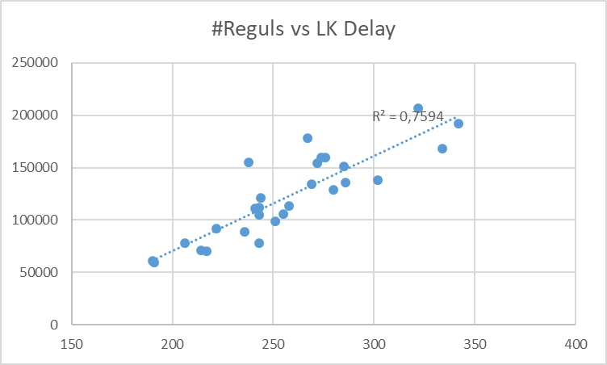
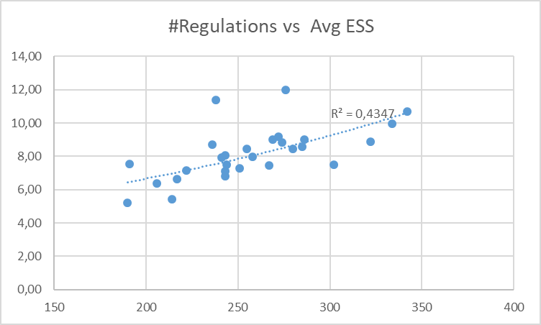
CASA simulation results analysis (AIRAC 1708)
More regulations, more capacity inefficiencies (empty slots)
More regulations, more delay
The average delay increases with the number of regulations.
The average number of empty slots also increases (capacity inefficiencies) ➔ it is perhaps the cause of the delay increase

Slide 11
How ECASA optimises: manual example
HMI used in RNEST
Flights can be sorted by optimisation potential
This flight for instance could potentially reduce the delay of 218 flights

Slide 12
In this case two regulations are penalised by the selected flight
In this case the flight can optimise the delay in 2 different regulations (175 flights in one + 45 in the other = 218 flights)

Slide 13
Penalisation of MGY3428M to MGY1228A
Note: approx. ETO position of the flight
If the delay of the flight in 1 is reduced by 24 min in MGY3428M then it will take a free slot in 4-5 instead of the slot in 2-3, thus saving 45 * 2 = 1.5 h delay in MGY1228A

Slide 14
Penalisation of MGY3428M to EHYR28
Note: approx. ETO position of the flight
If the delay of the flight in 1 is reduced by 24 min in MGY3428M then it will take a free slot in 6-7 instead of the slot in 2-3, thus saving 175 * 1:20 = 4 h delay in MGY1228A

Slide 15
Experimental setup

Slide 16
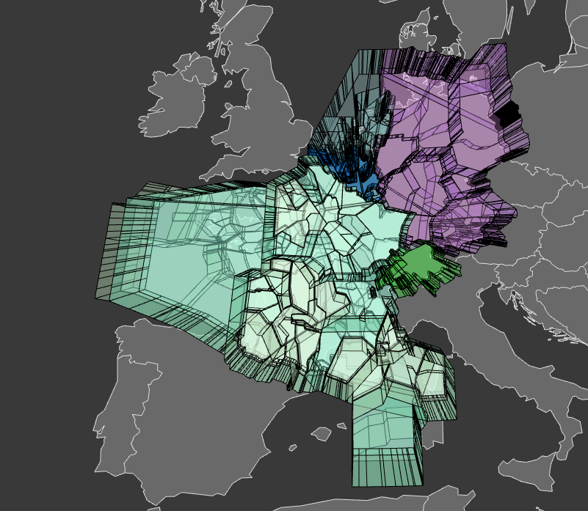
Simulation tool used: R-NEST Airspace simulated: ECAC Airspaces analysed: FABEC & MUAC
Main assumption: 1 single FAB covering ECAC (ideal SES concept)

Slide 17
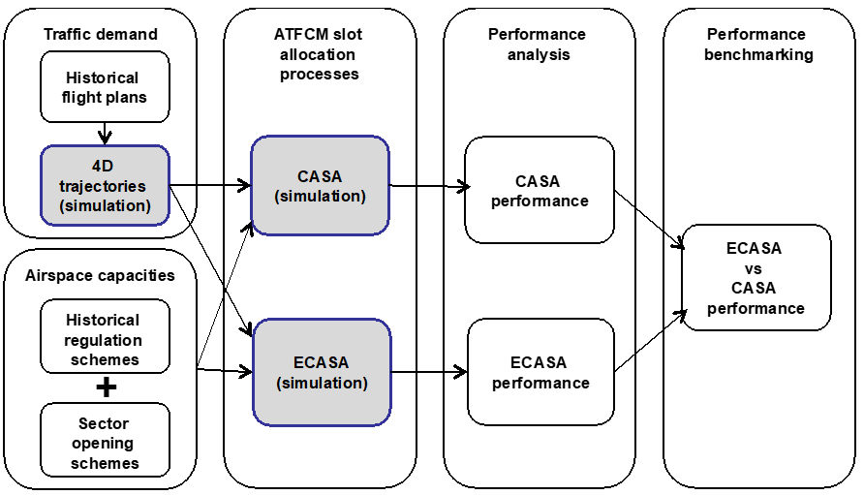
Research methodology
Data from AIRAC 1808 (mid Jul to mid Aug 2018)
ECASA performance will be analysed with these KPIs:
Delay in the network
Impact to AUs

Slide 18
Results and discussion

Slide 19
The more congestion the more optimisation potential
Optimisation in ECAC: between 18% and 35% (27% avg)

Slide 20
Average delay per regulation in the period (AIRAC 1808)
-30% minutes of delay
-31% minutes of delay

Slide 21
Total number of flights delayed in the airspace considered
-1064 flights delayed (-16%)
-221 flights delayed (-19%)

Slide 22
Number of flights delayed a certain number of minutes (delay distribution)
<15 min
>15 min
<15 min
>15 min
-50% flights delayed >15 min
-56% flights delayed >15 min
Typically, delays of less than 15 min can be considered negligible in terms of costs for the AUs

Slide 23
Share of flights in the CASA regulation sequences vs ECASA sequences
CASA
-3 points
+ 13 points
-8 points
+ 15 points
ECASA
-10 points
-7 points
Less % of flights delayed and less slots forced by external regulations

Slide 24
conclusions

Slide 25
Conclusions
The ATFCM processes are today done through local decisions with little awareness of the impact on the network
A centralised (de-fragmenting) coordination of the ATFCM slots allocation (e.g., through ECASA) could contribute to reconcile the various needs at local and network level
Substantial delay reductions have been achieved in simulations with ECASA (30% less delay in FABEC and MUAC compared to CASA, and 50% less flights delayed more than 15 min)
It is foreseen that a change in the performance scheme might be also necessary to encourage and smooth the operational coordination between ANSPs (& to include the ‘impact of delay’)

Slide 26
Back-up slides

Slide 27
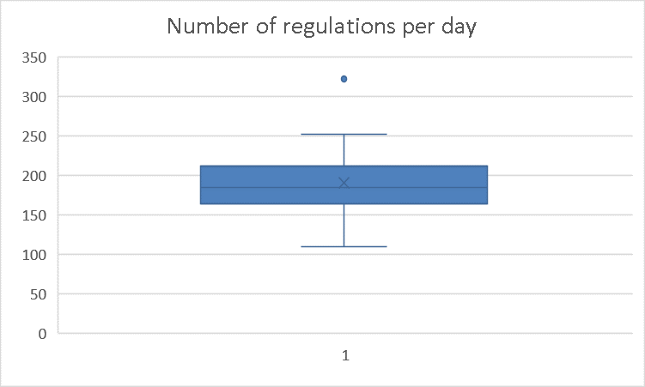
Number of regulations in FABEC in busiest period of summer 2018
Days analysed: from 20th July to 15th Aug 2018 (AIRAC 1808)
5152 regulations analysed in total
190 regulations per day in average
110 min, 322 max

Slide 28
Optimisation strategy implemented in ECASA
F in its ETO position

Slide 29
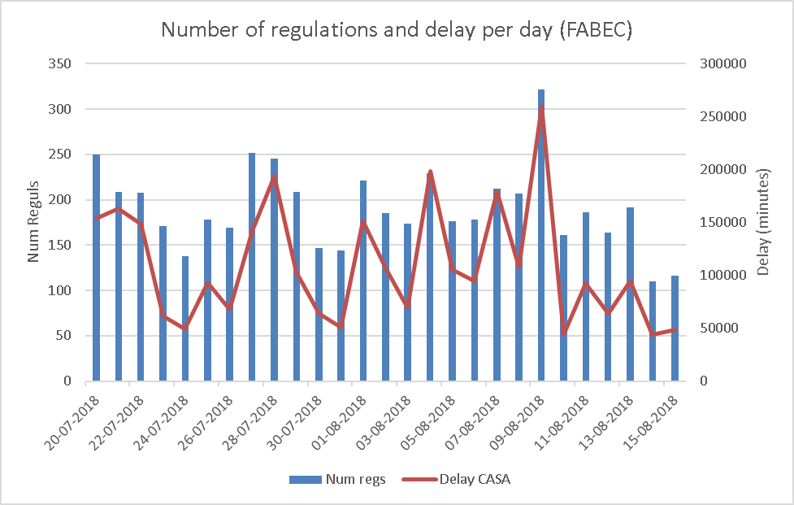
Number of regulations and (simulated) delay per day in FABEC

Slide 30
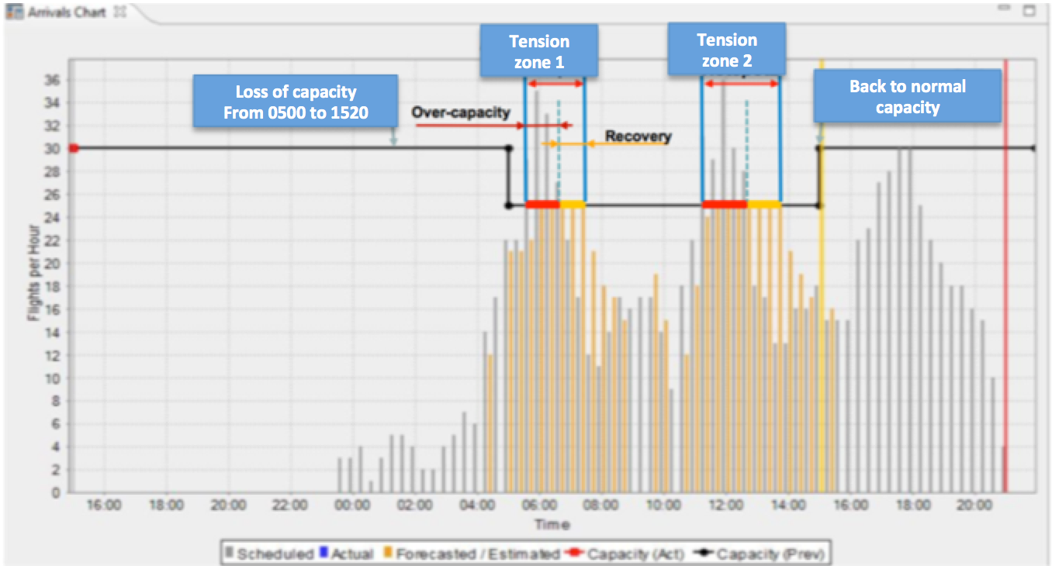
Definition of tension zones
Regulation period
Tension Zones: periods/positions in the sequence in which flights can take earlier positions (note: typically in TZs there is delay)

Slide 31
Properties of the interactions on flights: accumulative and commutative
Accumulative: the total net impact on a flight is direct addition of all the impacts received
Commutative: the order of the impacts does not alter the final sequence.
Note: Intermediate states and impacts may evolve differently with the change of order (but does not affect to the final sequence)
Simple example: flights forced in R1 by another MPR
Order 1:
First B, then X
Order 2:
First X, then B

Slide 32
Penalisations and Protections to TVs due to Regulations (network stability)
Common demand is the set of flights that get through at least traffic volumes A and B.
Penalising flights: the delay produced by A pushes flight f1 inside the observed period
Protecting flights: the delay produced by A pushes flight f2 outside the observed period
f2
f1
f2
f1
1
3
4
1
2
3
4
Throughput of traffic volume B before regulating traffic volume A
Throughput of traffic volume B after regulating traffic volume A
Throughput must be considered in addition to delay ➔ We will optimise capacity usage to minimise delay
ECASA solutions should not de-stabilise the network ➔ TVs should not receive too many additional flights

Slide 33
Definition of impact to AUs
Cost of delay on 1 flight
Flight on planned or re-planned time
(delay = 0)
Delay
Impact = large
Impact = 0
Non-linear cost structure due to :
PAX flow: transit, high yield
passengers, rotations,…
Resource Mgt. (cascade): curfew,
crew constraints, pilots
constraints, maintenance, ...
Impact = large
Impact = acceptable
Impact = acceptable
Typically, delays of less than 15 min have negligible costs for the AUs

Slide 34
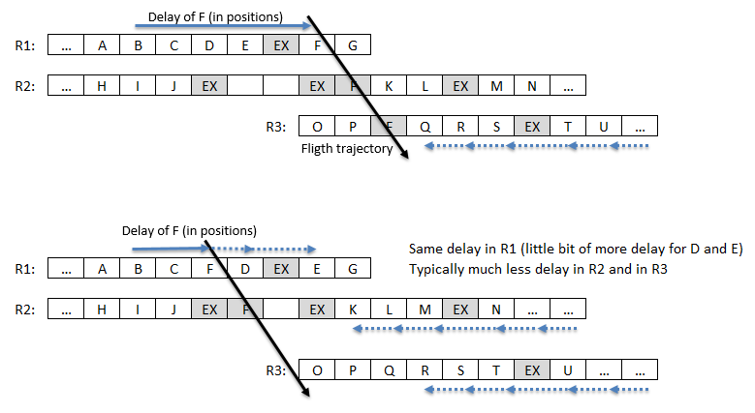
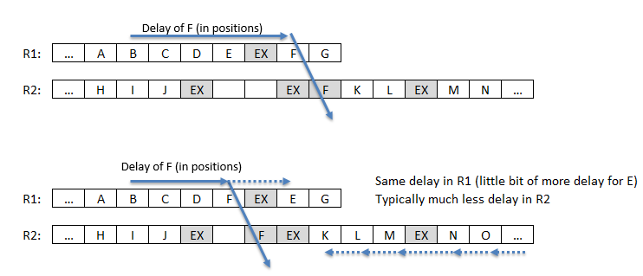
Strategy 1: Avoid flights entering into Tension Zones (of other regulations)
Empty slot
Slot used
Out of R3
Removing flights from the beginning of large tension zones can save hours of delay in a single regulation

Slide 35
Strategy 2: overloading slots nearby the existing empty slots
Case 1:
Empty slot
➔ Better usage of spare capacity (slots) with no negative impact on ATC workload and important reduction of delay
Used slot (compensating the nearby overload)
Case 2:
➔ Idem, but using the empty slots in the middle of the sequences
Used slot (compensating the nearby overload)

Slide 36
Strategy 3: systematic overloading of slots
Sometimes the ATCOs may have less workload if the traffic is smoothed by a regulation (less probability of bunching ➔ less complexity and less workload): TBC by ATC experts
This situation could perhaps be improved by adding a second rate parameter under control of the FMP: the overloading rate (e.g.: rate 60/3 ➔ 1 overload every 20 minutes)
Important delay reductions are expected, while the ATCO’s actual capacity could be better used during periods of congestion

